Slide 1

The Public Face of Enterprise Architecture
Providing clear communications in the media and online

Slide 2

The Practice of EA Is Not Healthy
Health of EA Function is Low, says 30% of EA
(EAEC Functional Performance Survey, 2012)
Two thirds of all EA groups are restructuring
(EAEC Org Structure Poll,, 2011)
60% of EA Budgets Flat or Falling
(EAEC Org Structure Poll,, 2011)
CIOs Less Satisfied with EA than the Architects themselves
(EAEC Insights, 2/2012)

Slide 3
How Can We Help?
From an Industry-wide perspective, we can do some things…
Communicate Innovative New Tools and Techniques
Develop and Offer Improved Training
Support Stakeholder Buy-In
Support Measurability Through Standardized Metrics

Slide 4
Supporting Stakeholder Buy-In
What are the Business leader’s impressions of EA?
Never needed it before.
They build applications, right?
Geeks who think that they know my business better than I do
What are IT stakeholder’s impressions of EA?
Big charts with boxes and lines that I can’t read and don’t need
How can I get out of standing in front of an ARB?
My project already has an architect… why do I want another one?
What are a bunch of ivory-tower, non-accountable seagulls going to add to my ability to deliver on time?
What are prospective architects hearing?
Is there prestige or better pay in Enterprise Architecture?
What do these people actually do?
Practitioners are always bickering about definitions

Slide 5


Addressing Stakeholder Buy-In Issues
Consistent messaging
online
in training classes
In reference materials
Better integration with other Frameworks / Practices
Remove FUD from “peers” (Process Arch, Biz Arch, Solution Arch)
Make EA easier to integrate with: PMBOK, ITIL, Six Sigma
Move from “art” to “science”
Publication of serious studies
Publicity around proven value case studies
We can do this now
Depends on EABOK
Depends on EABOK

Slide 6
Messaging Targets
Online Messaging Sources:
Wikipedia → The most heavily used online reference work
Online journals
Blogs and Articles
Print Media Sources:
Business Magazines
Technology Magazines and Journals
Published Frameworks and Reference Materials
In-Person Sources:
Conference Presentations
Training classes
Analysts
Consultants
Practitioners

Slide 7
Special case: Wikipedia
Wikipedia is an online encyclopedia
Crowd sourced
Strictly controlled by policies and self-appointed ‘editors’
Elected ‘administrators’ oversee content
Five Pillars of Wikipedia
Wikipedia is an Encyclopedia
Wikipedia is written from a Neutral Point of View
Wikipedia is free content that can be used by anyone
Editors should interact in a respectful and civil manner
Wikipedia has no fixed rules

Slide 8
Making Wikipedia Work for EA
Consideration | Meaning | Requirement
Notability | Many sources have to consider your topic valid | Each article must be notable. [consistency is highly valuable]
No Original Research | Publish elsewhere, cite in Wikipedia | Easily verified content, not locked down under memberships
Copyright concerns | Content in Wikipedia is out of our control | Release content for use in Wikipedia so that it can be cited
Control over editing | We cannot control edits or editors | Develop a strong article from a clear voice that is authoritative without being controversial, and monitor it over time.

Slide 9
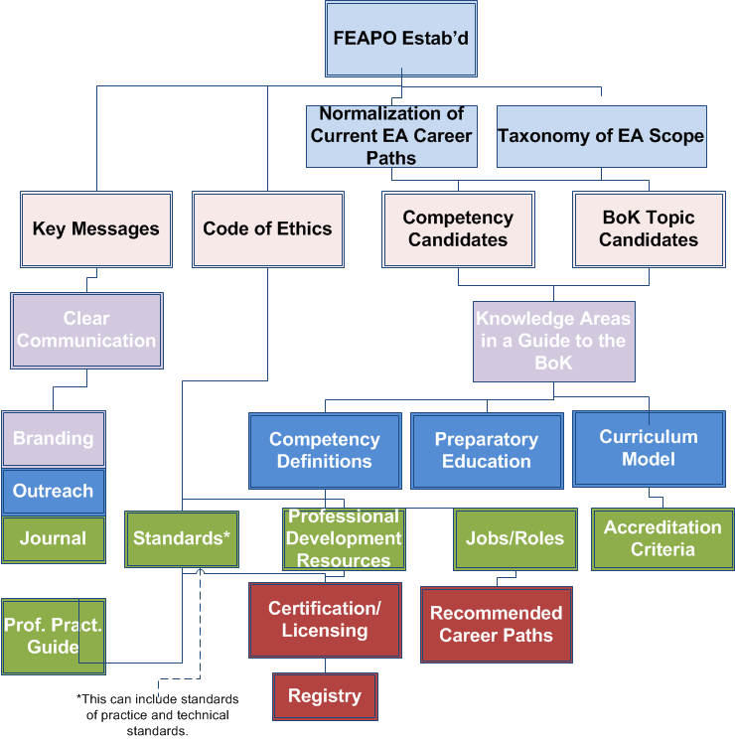
Overview of the Proposed Roadmap
Milestones/ KPI’s
Inception
Foundation
Education
Acknowledgement
Registration
Profession
Maintenance
Notes:
Inception – do we have the critical mass necessary for accreditation to occur. Until we have that in place we cannot establish the scope of our efforts. In education we have no idea of the subject areas until we have that critical mass of organizations. FEAC Institutes, for example, added introductory social network analysis to their tests. Considering that this is now the hottest new science (and has nothing to do with social media btw) we could miss this area entirely. DAMA brings in information that is critical as does the Business Architects Guild. When we feel that this critical mass is met (i.e. 80% of the scope is well known)
Foundation – do we have the pieces in place to do this. It is one thing to develop a set of standards and get them adapted, it is another to manage them. Setting up accreditation for education takes infrastructure. We can certainly have a reference set of classes to work from and even have universities adopt them, but for professional accreditation we have to include extensive review processes as well.
Education – How do we educate the masses. This is more than just charting out the body of knowledge. How do we effectively disseminate and administer this knowledge. Lawyers may argue about the finer points of the law and even what justice is, but legal dissemination and administration from case law and west law to schools keeping up with the field is consistent across the whole profession.
Registration – How much education do we expect for someone to be registered. Consider medicine. If we required all of the areas of medicine to be well understood there would be no doctors. What do we select and how much.
Acknowledgement – What an enterprise architect knows has to be understood by the public at large. Even more so than software development or software engineering. It must be intuitive to really become a profession like the others.
Profession – Is this education enough to make the field unique? This is an ever-changing thing.

Slide 10
Deliverable
Develop and Publish a single white paper on Enterprise Architecture
Specifically written for the non-practitioner
Content targeted at multiple outlets, incl. Wikipedia
Co-published or adopted by multiple FEAPO members
Design for publication
Target specific journals / magazines / blogs
Work with editors and authors prior to publication wherever it makes sense

Slide 11
Overview of Deliverable
1. Short Intro to EA
2. Why Organizations Need EA and When EAs Get Engaged
2.1 Value Proposition
2.2 EA in Planning
2.3 EA in Design
2.4 EA in Strategic Response
3. EA Outputs and how they are used
3.1 Static Visualizations (Current state, future state)
3.2 Dynamic Visualizations (Roadmaps, flow models)
3.3 Influence and Governance (Balanced Scorecards, Strategy Maps)
4. Basic EA Concepts
4.1 Discussion of the terms "Enterprise" and "Architecture"
4.2 Discussion of the term Model, and why we use modeling techniques
4.3 Strategic Alignment - what does it mean and why do we want it
4.4 Simplicity and Efficiency through shared processes and platforms
4.5 How does the enterprise develop and innovate on their business models
5. Common EA Techniques
5.1 Information gathering, categorization, storage, and visualization
5.2 Capability Modeling
5.3 Business Modeling
5.4 Current state, transition states and future state models
5.5 Roadmaps and reporting
6. Considerations
6.1 Relationship to Governance
6.2 Schools of thought
6.3 Variations by organization type and industry
6.4 Emergence into Education
7. References and Links

Slide 12
Team Structure
Owner – FEAPO
Sponsor – Brian Cameron
Team Leader – Nick Malik
Core Contributors from multiple FEAPO members
Credible and respected by publications
Nomination process?
Extended contributors / community
Allows for contribution from non-members
Helps to build buy-in for final result
Who owns the contributions?

Slide 13
Development Process
Nominated Contributors
EA Influencers
Community Input
Collaboration Web Site set up
Grad Student creates questionnaire, interviews contributors
Grad Student compiles raw contributions and places on web site
Team leader and grad student develop first draft of actual paper.
Contributors review first draft and markup with feedback. New edition created. (perform this step twice)
Influential authors and well-known speakers provide feedback and markup.
Grad student turns feedback into specific change requests. Core Team discusses and adopts specific change requests.
Vetted community members invited to provide feedback.
(repeat step #7)
Document reviewed by full FEAPO board and submitted for adoption.

Slide 14
TIMELINE
1 | 3/2012 | Charter approved, contributor nominations accepted
2 | 4/2012 | Contributors interviewed, contributions compiled
3 | 5/2012 | Key messages distilled, rough draft circulates
4 | 6/2012 | Early version circulates, community input requested
5 | 7/2012 | Draft submitted to FEAPO leadership for approval
6 | 8/2012 | Draft submitted to member organizations for approval
7 | ~3/2013 | At least three member organizations ratify
8 | 5/2013 | Submitted to journals and magazines for publication

Slide 15
Approval to proceed?
Do we invest in this activity at this time?
Do we want to include the Wikipedia constraints (especially around IP)?
Do we want to include input from independent authors and/or community?

